Slide 1

Arabic Sentiment Analysis Project
Digital Egypt Pioneers Initiative - DEPI
AWS Machine Learning

Slide 2

Introduction to Arabic Sentiment Analysis
Market Analysis
Understanding consumer sentiment can help
01
businesses adapt their products and marketing strategies effectively.
Social Media Monitoring
Real-time analysis of social media can gauge public opinion and brand perception in the Arabic-speaking world.
02
Customer Feedback
Analyzing customer reviews and feedback aids in improving services and enhancing customer satisfaction.
03
Political Discourse
Sentiment analysis can provide insights into public sentiments towards politicians and policies in Arab countries.
04

Slide 3

Importance of Sentiment Analysis in Arabic
Enhance User Engagement
Leverage sentiment analysis to tailor content for better audience interaction.
Brand Reputation Management
Monitor sentiment to promptly address issues affecting brand image.
01
03
Customized Marketing Strategies
Utilize sentiment insights to create targeted marketing campaigns effectively.
Market Trend Insights
Extract insights on consumer behavior trends for strategic decision- making.
02
04

Slide 4
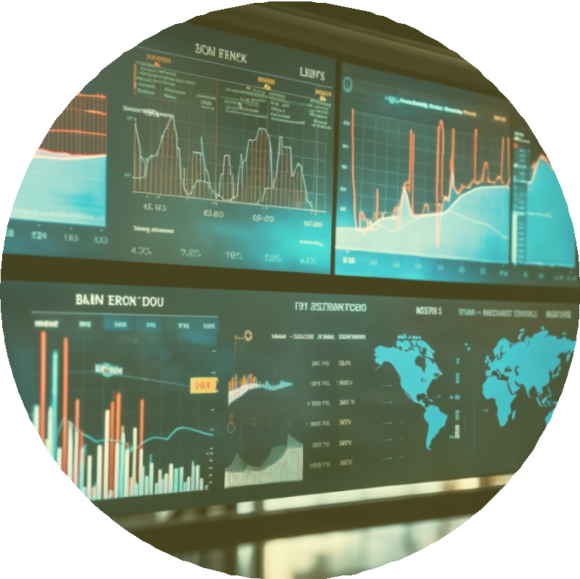
Challenges in Arabic NLP and Sentiment
Arabic dialects vary significantly across regions, making sentiment analysis challenging. Identifying nuances, slang, and context-specific meanings can lead to inaccuracies in emotion detection which needs functional resources like annotated datasets and robust models to effectively understand sentiments accurately.

Slide 5
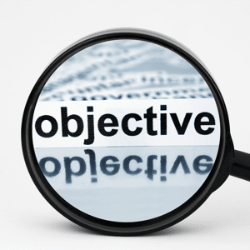
Project Objectives
The project aims to build an end-to-end Arabic sentiment analysis pipeline on AWS that classifies company reviews into positive or negative sentiments, automates the full ML lifecycle, and deploys a real-time API, delivering valuable insights for businesses, investors, and researchers to improve service quality, boost profitability, and uncover market opportunities.

Slide 6

Dataset Description
Dataset Overview
The dataset contains 40,046 reviews from customers about various companies, written in Arabic. Each review is labeled with a sentiment score and is associated with a specific company.
Columns:
Review description (Text) – The actual customer review.
rating (Numeric) – Sentiment score:
1 → Positive review
0 → Neutral review
-1 → Negative review
company (Text) – The company being reviewed.

Slide 7
Dataset Problems
Duplicated Reviews
Many reviews were exact duplicates (same text and rating).
Needed to be removed to avoid bias and overfitting.
Conflict Reviews
Some reviews had the same text but were labeled with different sentiments (e.g., both -1 and 1).
Creates label noise and confuses the model.
Neutral Reviews Are Misleading
Reviews labeled as 0 (neutral) were often vague, incomplete, or not truly neutral.
Example: "تمام" (fine) might actually be positive.
Neutral reviews were removed to improve binary classification.
Reviews Containing Only Emojis
Some reviews had no words, only emojis like 😂❤️😠.
These were replaced, or emojis were converted to text using mapping.
🗣 Dialects, Misspellings & Slang
Colloquial dialects (e.g., Egyptian, Gulf)
Spelling mistakes (e.g., ممممتاز → ممتاز)
Non-standard grammar
Required normalization, elongation removal, and lemmatization.

Slide 8
Dataset Problems
Text Elongation
Many reviews contain repeated letters for emphasis, such as: "رااااائع", "جمممميل".
These distort word meaning and increase vocabulary size unnecessarily.
Handled by applying elongation reduction rules to normalize the text.
Numbers in Text
Some reviews contain embedded numbers, e.g., "المنتج وصل خلال 3 أيام".
Numbers were not useful for sentiment and could add noise.
Decided to remove all numbers entirely during preprocessing.
Subjectivity Filtering
Some reviews are purely factual or objective with no emotional tone.
Used a pretrained HuggingFace model to filter only subjective reviews.
Objective reviews were removed to improve sentiment signal quality.
Class Imbalance
The dataset is imbalanced with a high number of positive reviews (~59%).
Neutral reviews are underrepresented and often too vague.
Resolved by either:
Removing neutral reviews entirely for binary classification.
Optionally oversampling minority classes (if using 3-class setup).

Slide 9


Data Collection and Preprocessing Techniques
Data Sources
Identify and collect data from various Arabic social media platforms.
Data Cleaning
Remove unwanted characters and irrelevant information from the dataset.
Tokenization
Split the Arabic text into individual words or tokens for analysis.
Normalization
Standardize text by converting it to a consistent format in Arabic.
Stop Words
Filter out common Arabic stop words that do not add value.
Sentiment Labels
Assign sentiment labels based on predefined criteria for classification.
Dataset Split
Divide the dataset into training, validation, and testing subsets.

Slide 10
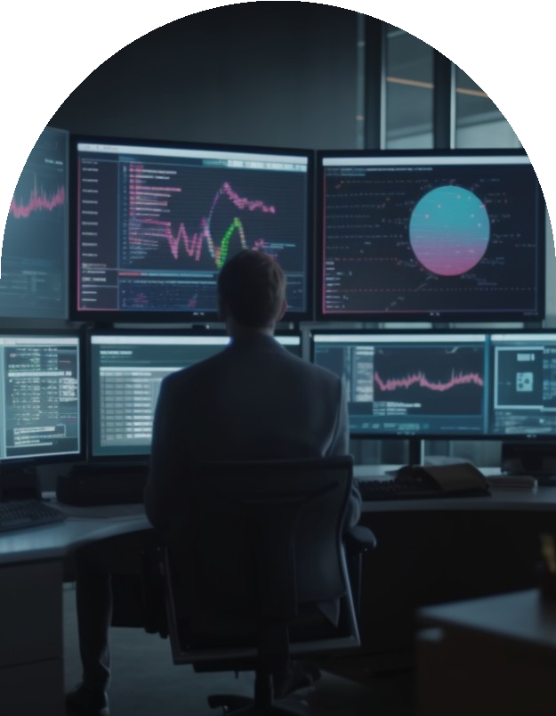
Exploring Sentiment Analysis Methods
Data Collection
Gather diverse Arabic text data from social media platforms.
Sentiment Modeling
Utilize machine learning algorithms to predict sentiments accurately.
01
05
Preprocessing
Clean text by removing noise and irrelevant characters efficiently.
Evaluation Metrics
Implement precision, recall, and F1 score for assessing model performance.
02
06
Tokenization
Segment text into meaningful units for analysis easily.
Deployment
Integrate the model using streamlit with flask api for real-time sentiment analysis.
03
07
Feature Extraction
Transform texts into numerical features for model training using TFIDF, Embeddings.
User Feedback
Collect user feedback to continuously improve sentiment accuracy.
04
08

Slide 11

Machine Learning Techniques for Analysis
Sentiment Classification
Utilize supervised learning algorithms like SVM,Logistic Regression, Random Forest, XGBoost (Extreme Gradient Boosting) to classify Arabic text into positive, negative, or neutral sentiment categories based on labeled training data.
Feature Extraction
Implement techniques such as TF-IDF and word embeddings to extract relevant features from Arabic text, enhancing the model’s ability to understand linguistic nuances for sentiment detection.
01
02

Slide 12

Deep Learning Approaches in Sentiment Analysis
LSTM
01
Used to capture long-term dependencies in Arabic text and model the sequential flow of language.
GRU
A faster and simpler alternative to LSTM that achieved competitive results with fewer parameters.
.
02
AraBert
A powerful pre-trained transformer model fine-tuned for Arabic sentiment classification, delivering the best performance among all models tested.
03

Slide 13

Tools and Libraries for Arabic Sentiment Analysis
NLTK
Utilized for preprocessing and tokenization tasks in Arabic text.
Scikit-learn
Implemented for training various machine learning classifiers.
01
04
TensorFlow
Framework chosen for building and deploying sentiment analysis models.
Streamlit
Provided tools for named entity recognition and sentiment.
02
05
Flask
Used for word embeddings to enhance feature representation.
Transformers
Applied subjectivity for sentences
03
06

Slide 14
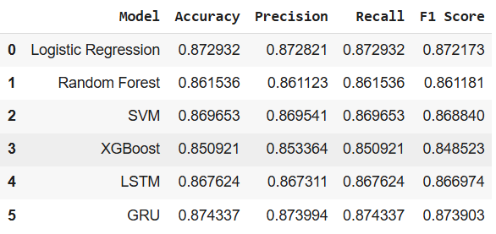

Evaluation Metrics for Sentiment Models

Slide 15
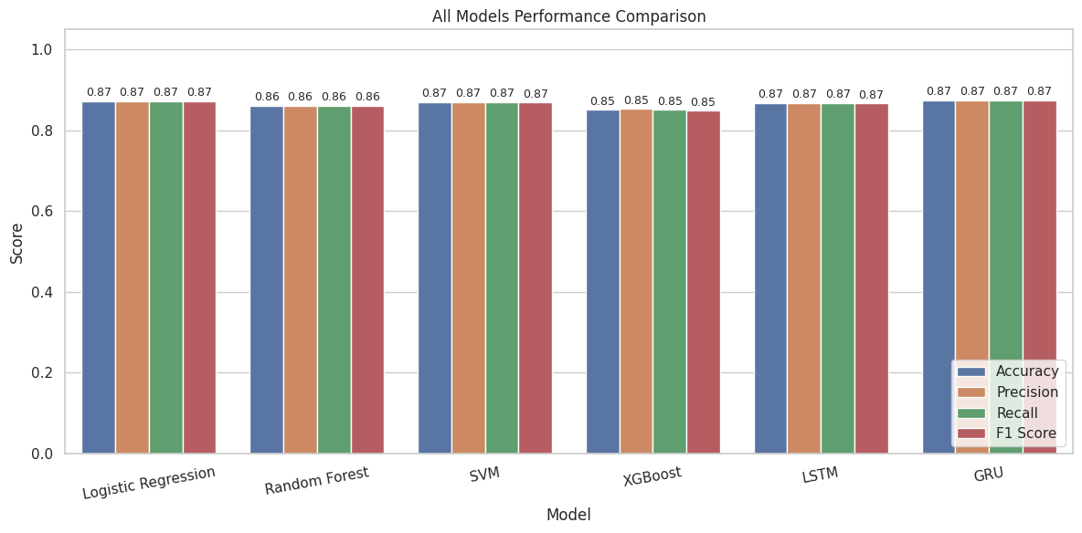

Slide 16
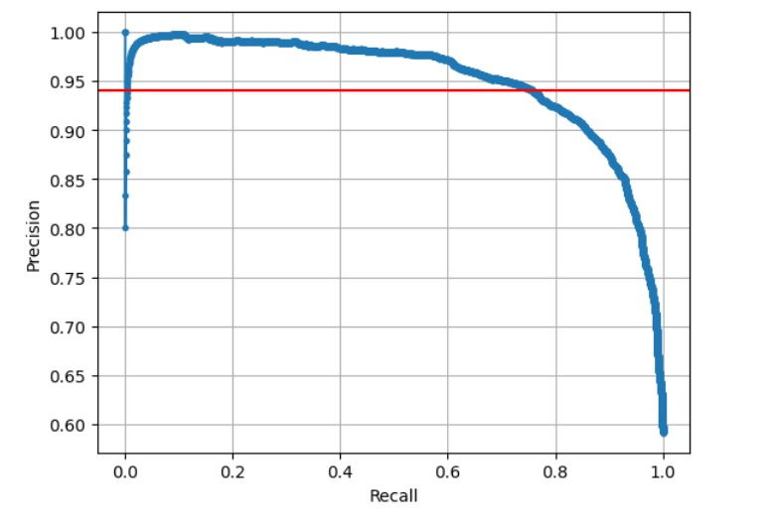
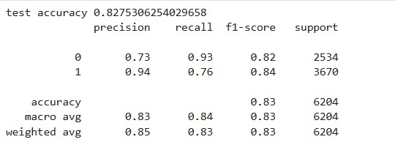
Champion Model: Logistic Regression

Slide 17

Thank You

